Slide 1


MICROSOFT EMS COMMUNITY
WELCOME TO
CloudHour
We will start shortly. Grab a drink and pull up a chair.
WED · [DATE]
Live round-table · Intune · Entra ID · Defender · Purview
Hosted by MS EMS team
Notes:
Welcome. CloudHour is the Microsoft EMS Community monthly round-table. Today [DATE]. Host [HOST NAME], co-host [CO-HOST NAME].

Slide 2

TODAY'S CO-HOST
[NAME]
[JOB TITLE]
[Known from]
[Badge logo]
[Badge 1]
[Badge 2]
[Website 1]
Hosted by MS EMS team · https://aka.ms/m365emsdiscord
CloudHour · Microsoft EMS Community · [Month Year]
2
Notes:
Introduce [CO-HOST NAME], [JOB TITLE]. [Known from / background]. [Why they are co-hosting this session].

Slide 3



THE FORMAT
What is CloudHour?
A monthly round-table where the community digs into a few key topics together. Live, practical and unscripted.
Why it matters
How you benefit
Shape what is next
The EMS stack moves fast. CloudHour keeps the community current on what is changing and what it means in practice.
Real-time discussion with hosts and peers. Ask anything, share your take, learn how others run it.
Bring the topics you care about. The community helps set the agenda for next month.
CloudHour · Microsoft EMS Community · [Month Year]
3
Notes:
Set expectations. A conversation, not a webinar. Brief a topic, then open the floor.

Slide 4


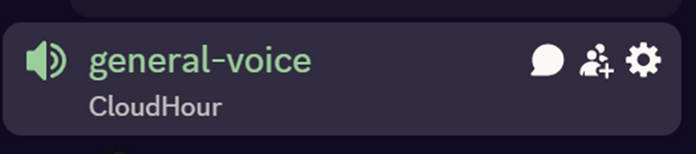
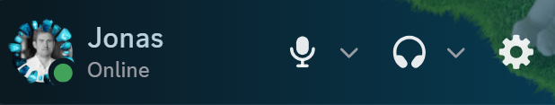
HOUSEKEEPING
Before we start
Prefer to listen?
Open mic is on
Use the chat
No pressure to speak. Mute up and enjoy the conversation.
Jump in anytime. This is a chat, not a webinar.
Drop links, questions and hot takes as we go.
YOU ARE HERE
Mute and unmute live bottom-left in Discord. Open mic just means unmute and talk.
CloudHour · Microsoft EMS Community · [Month Year]
4
Notes:
Housekeeping. Mute to listen, open mic welcome, use chat for links and questions.

Slide 5

WORTH A BOOKMARK
Links to share
[Link 1 title]
[Link 2 title]
[Link 1 URL or description]
[Link 2 URL or description]
[Link 3 title]
[Link 4 title]
[Link 3 URL or description]
[Link 4 URL or description]
[Link 5 title]
[Link 6 title]
[Link 5 URL or description]
[Link 6 URL or description]
[Link 7 title]
[Link 7 URL or description]
CloudHour · Microsoft EMS Community · [Month Year]
5
Notes:
[Why each link is worth a bookmark]

Slide 6
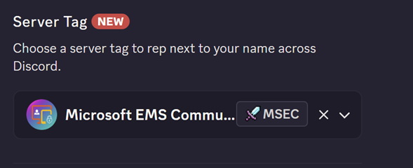
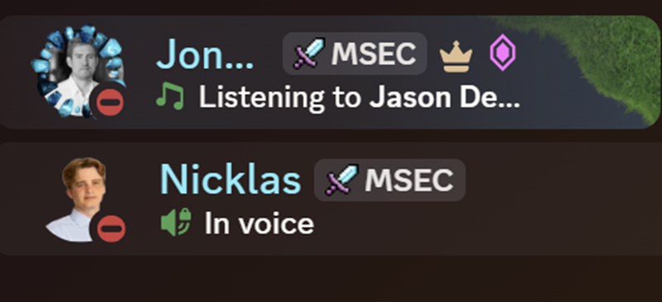
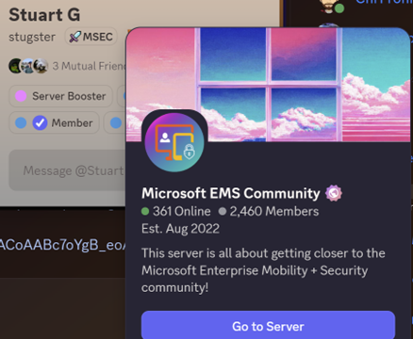
REP THE COMMUNITY
Add the MSEC server tag
1
Open Discord, then your profile
Click your name bottom-left, then Edit Profile.
2
Choose Server Tag
Pick Microsoft EMS Community from the list.
3
Wear it everywhere
The MSEC tag shows next to your name across Discord.
CloudHour
· Microsoft EMS Community · [Month Year]
6
Notes:
Set the Microsoft EMS Community server tag in Discord. Join: https://aka.ms/M365EMSDiscord

Slide 7

TODAY'S AGENDA
On the table
[Number of topics] changes hitting your tenant. A quick brief on each, then we open the floor. We will not get to all of them, so pick your battles.
1
[Topic 1 title]
4
[Topic 4 title]
[DATE]
[DATE]
[Topic 1 workload · area]
[Topic 4 workload · area]
2
[Topic 2 title]
5
[Topic 5 title]
[DATE]
[DATE]
[Topic 2 workload · area]
[Topic 5 workload · area]
3
[Topic 3 title]
6
[Topic 6 title]
[DATE]
[DATE]
[Topic 3 workload · area]
[Topic 6 workload · area]
Plus: topic from the crowd. Open floor, bring your own.
CloudHour
· Microsoft EMS Community · [Month Year]
7
Notes:
[Number of topics] topics, balanced across [workloads] and across [platforms]. [Item to mention from the radar board next].
[TEMPLATE STRUCTURE] Each topic is a block: 1 topic detail slide (TOPIC N · [WORKLOAD · AREA]) + 1 round-table slide (Let us talk). Optional extra slides per topic: bullet summary (What it is / What it solves / Who is affected), image or screenshot, community quiz. Duplicate or delete blocks to fit the session: fewer, longer topics or more, shorter ones. Remove unused agenda cards (max 6) and renumber TOPIC N.

Slide 8



NEXT 90 DAYS
On the radar
IDENTITY & ACCESS
ENDPOINTS WIN/DROID/iOS
DEFENDER & DATA
[DATE]
[DATE]
[DATE]
[Radar item 1]
[Radar item 5]
[Radar item 9]
[DATE]
[DATE]
[DATE]
[Radar item 2]
[Radar item 6]
[Radar item 10]
[DATE]
[DATE]
[DATE]
[Radar item 3]
[Radar item 7]
[Radar item 11]
[DATE]
[DATE]
[DATE]
[Radar item 4]
[Radar item 8]
[Radar item 12]
CloudHour
· Microsoft EMS Community · [Month Year]
8
Notes:
90-day board. Sources: [Radar item 1]: [URL] ; [Radar item 2]: [URL] ; [Radar item 3]: [URL] ; [etc.]

Slide 9

TOPIC 1 · [WORKLOAD · AREA]
[Topic 1 title]
[Topic 1 subtitle]
[Heading 1]
DEADLINE
[Text 1]
[DATE]
[Heading 2]
[Text 2]
[Deadline summary]
[Heading 3]
[Text 3]
WHO IS AFFECTED
[Who is affected]
[Heading 4]
[Text 4]
Source: [Source]
CloudHour
· Microsoft EMS Community · [Month Year]
9
Notes:
[Message Center ID and publish date, if applicable]. [Topic 1 summary: what changes, who is affected, recommended action].
Sources: [URL] and [URL]

Slide 10
TOPIC 1 · ROUND-TABLE
Let us talk: [Topic 1 short name]
[Discussion question 1]
[Discussion question 2]
[Discussion question 3]
[Discussion question 4]
Unmute and jump in. There are no wrong answers here.
CloudHour
· Microsoft EMS Community · [Month Year]
10

Slide 11
TOPIC 1 · ROUND-TABLE
Let us talk: [Topic]
What it solves
What it is
[Bullet points]
[Bullet points]
Who is affected
[Bullet points]
Unmute and jump in. There are no wrong answers here.
CloudHour
· Microsoft EMS Community · [Month Year]
10

Slide 12
TOPIC 1 · ROUND-TABLE
[Slide title]
[Article or tool title]
[Image or screenshot]
Unmute and jump in. There are no wrong answers here.
CloudHour
· Microsoft EMS Community · [Month Year]
10

Slide 13

TOPIC 2 · [WORKLOAD · AREA]
[Topic 2 title]
[Topic 2 subtitle]
[Heading 1]
DEADLINE
[Text 1]
[DATE]
[Heading 2]
[Text 2]
[Deadline summary]
[Heading 3]
[Text 3]
WHO IS AFFECTED
[Who is affected]
[Heading 4]
[Text 4]
Source: [Source]
CloudHour
· Microsoft EMS Community · [Month Year]
11
Notes:
[Message Center ID and publish date, if applicable]. [Topic 2 summary: what changes, who is affected, recommended action].
Sources: [URL] and [URL]

Slide 14
TOPIC 2 · ROUND-TABLE
Let us talk: [Topic 2 short name]
[Discussion question 1]
[Discussion question 2]
[Discussion question 3]
[Discussion question 4]
Unmute and jump in. There are no wrong answers here.
CloudHour
· Microsoft EMS Community · [Month Year]
12

Slide 15

TOPIC 3 · [WORKLOAD · AREA]
[Topic 3 title]
[Topic 3 subtitle]
[Heading 1]
DEADLINE
[Text 1]
[DATE]
[Heading 2]
[Text 2]
[Deadline summary]
[Heading 3]
[Text 3]
WHO IS AFFECTED
[Who is affected]
[Heading 4]
[Text 4]
Source: [Source]
CloudHour
· Microsoft EMS Community · [Month Year]
13
Notes:
[Message Center ID and publish date, if applicable]. [Topic 3 summary: what changes, who is affected, recommended action].
Sources: [URL] and [URL]

Slide 16
TOPIC 3 · ROUND-TABLE
Let us talk: [Topic 3 short name]
[Discussion question 1]
[Discussion question 2]
[Discussion question 3]
[Discussion question 4]
Unmute and jump in. There are no wrong answers here.
CloudHour
· Microsoft EMS Community · [Month Year]
14

Slide 17

TOPIC 4 · [WORKLOAD · AREA]
[Topic 4 title]
[Topic 4 subtitle]
[Heading 1]
DEADLINE
[Text 1]
[DATE]
[Heading 2]
[Text 2]
[Deadline summary]
[Heading 3]
[Text 3]
WHO IS AFFECTED
[Who is affected]
[Heading 4]
[Text 4]
Source: [Source]
CloudHour
· Microsoft EMS Community · [Month Year]
15
Notes:
[Message Center ID and publish date, if applicable]. [Topic 4 summary: what changes, who is affected, recommended action].
Sources: [URL] and [URL]

Slide 18
TOPIC 4 · ROUND-TABLE
Let us talk: [Topic 4 short name]
[Discussion question 1]
[Discussion question 2]
[Discussion question 3]
[Discussion question 4]
Unmute and jump in. There are no wrong answers here.
CloudHour
· Microsoft EMS Community · [Month Year]
16

Slide 19



TOPIC 5 · [WORKLOAD · AREA]
[Topic 5 title]
[Topic 5 subtitle]
[Heading 1]
DEADLINE
[Text 1]
[DATE]
[Heading 2]
[Text 2]
[Deadline summary]
[Heading 3]
[Text 3]
WHO IS AFFECTED
[Who is affected]
[Heading 4]
[Text 4]
Source: [Source]
CloudHour
· Microsoft EMS Community · [Month Year]
17
Notes:
[Message Center ID and publish date, if applicable]. [Topic 5 summary: what changes, who is affected, recommended action].
Sources: [URL] and [URL]

Slide 20
TOPIC 5 · ROUND-TABLE
Let us talk: [Topic 5 short name]
[Discussion question 1]
[Discussion question 2]
[Discussion question 3]
[Discussion question 4]
Unmute and jump in. There are no wrong answers here.
CloudHour
· Microsoft EMS Community · [Month Year]
18

Slide 21
TOPIC 6 · [WORKLOAD · AREA]
[Topic 6 title]
[Topic 6 subtitle]
[Heading 1]
DEADLINE
[Text 1]
[DATE]
[Heading 2]
[Text 2]
[Deadline summary]
[Heading 3]
[Text 3]
WHO IS AFFECTED
[Who is affected]
[Heading 4]
[Text 4]
Source: [Source]
CloudHour
· Microsoft EMS Community · [Month Year]
19
Notes:
[Message Center ID and publish date, if applicable]. [Topic 6 summary: what changes, who is affected, recommended action].
Sources: [URL] and [URL]

Slide 22
TOPIC 6 · COMMUNITY QUIZ
Quick quiz: [Quiz question]
[Question scenario or full question text]
[Answer A]
[Answer B]
[Answer C]
[Answer D]
[Answer E]
Vote in chat, then we talk it through. Answer is in the notes.
CloudHour
· Microsoft EMS Community · [Month Year]
20
Notes:
Answer: [Correct answer]. [Short explanation, and why the other options are wrong]. [Where the question comes from]. Sources: [URL] and [URL]

Slide 23

OPEN FLOOR
Topic from the crowd
Your turn.
What is eating your week, what broke this month, and what do you want next month CloudHour to dig into?
What is your biggest EMS headache right now?
A win worth sharing with the room?
A topic for next month?
The floor is yours. Unmute and go.
CloudHour
· Microsoft EMS Community · [Month Year]
21
Notes:
Open floor. Capture next month topic ideas in chat.

Slide 24
MICROSOFT EMS COMMUNITY
Thank you
for joining CloudHour. See you next month, and bring a colleague.
aka.ms/M365EMSDiscord
msems.community
Independent and community-run. Not affiliated with, endorsed by, or sponsored by Microsoft. Product names are trademarks of the Microsoft group of companies.
Notes:
Wrap up. Discord https://aka.ms/M365EMSDiscord and https://www.msems.community/

